Slide 1
Minimal API Project

Slide 2
1 Remove Weather related files

Slide 3
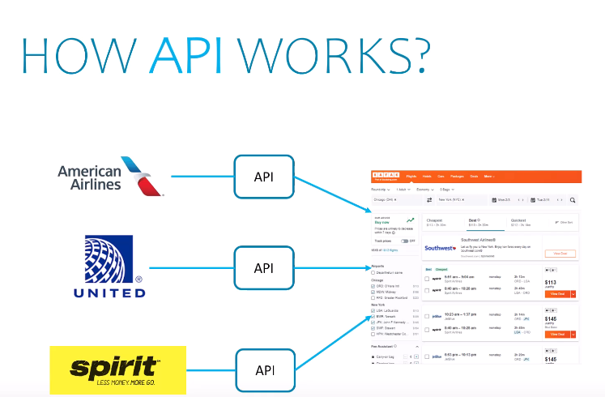

Slide 4
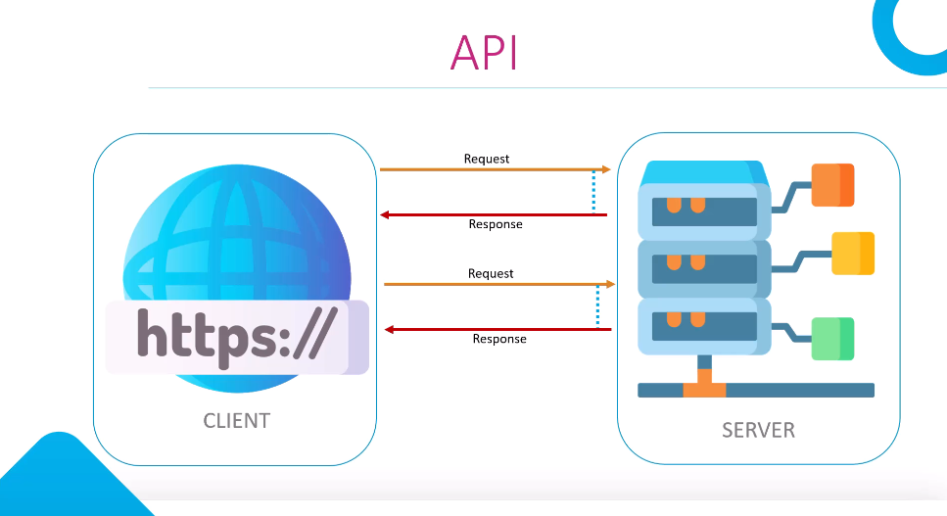

Slide 5
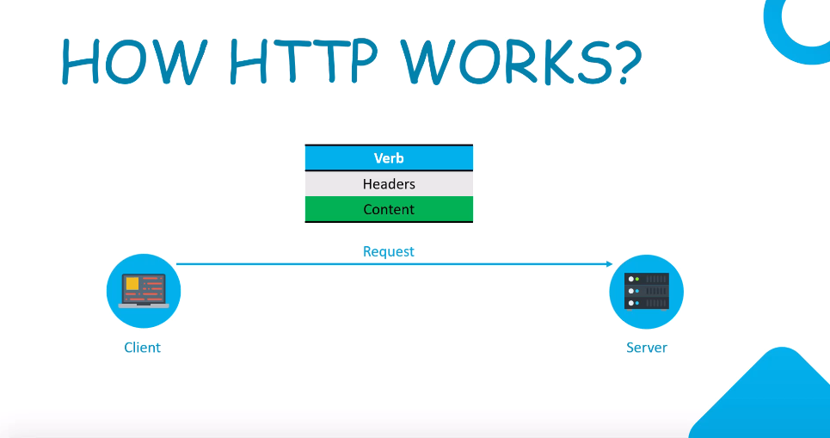

Slide 6
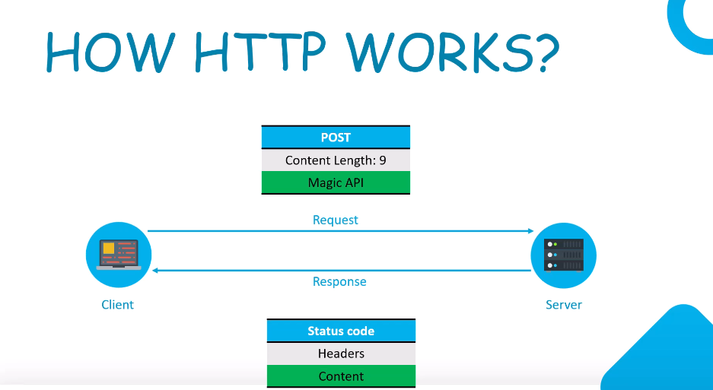

Slide 7
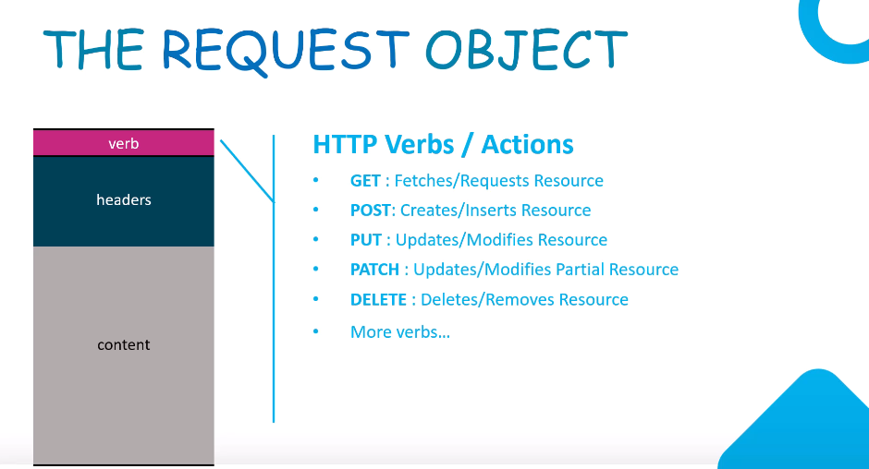

Slide 8
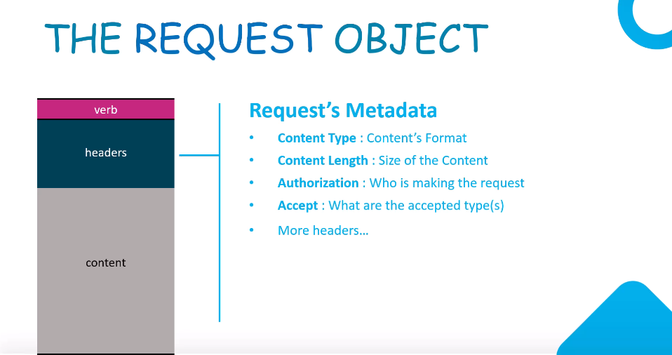

Slide 9
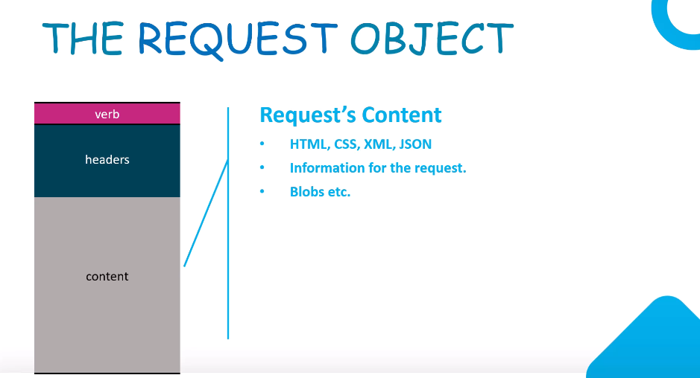

Slide 10
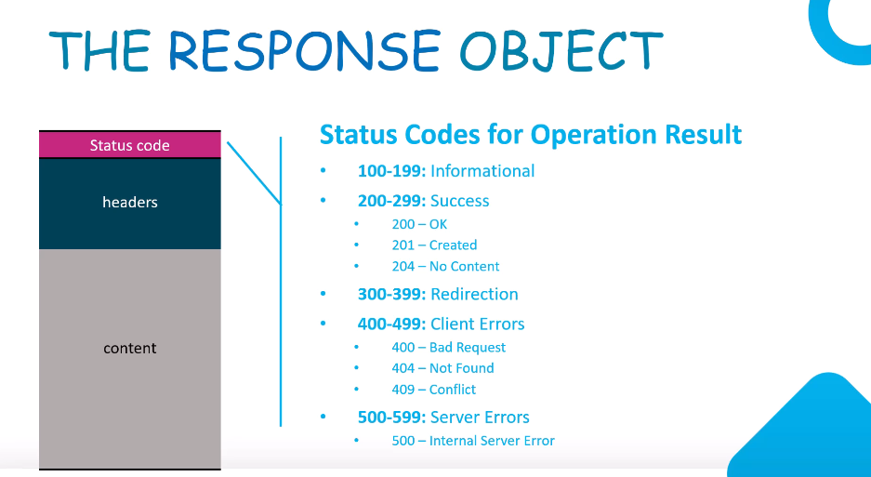

Slide 11
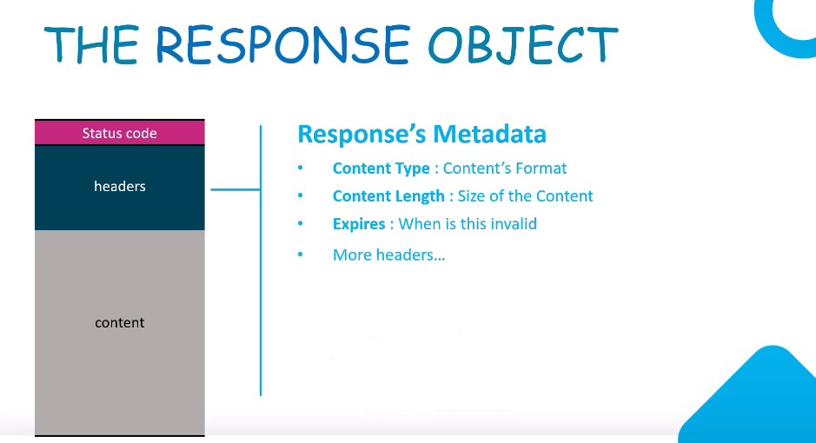

Slide 12
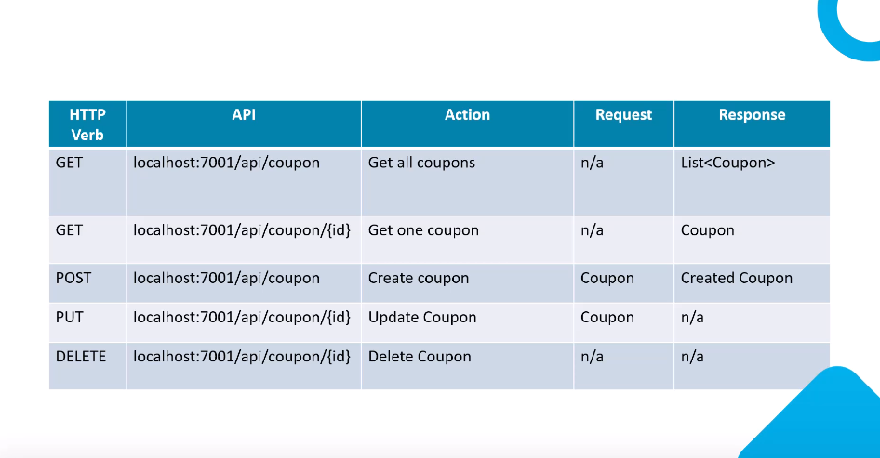

Slide 13
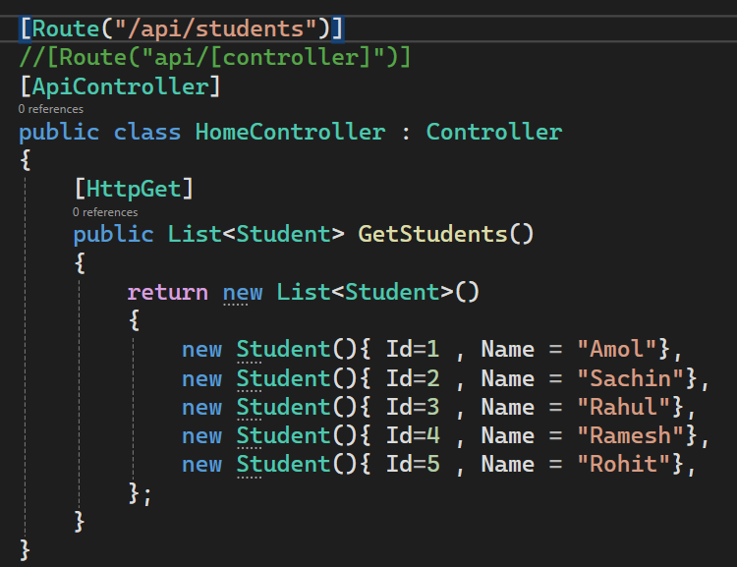
1. Add Controller – First Endpoint
Add Controller [ right click on controller folder ]

Slide 14
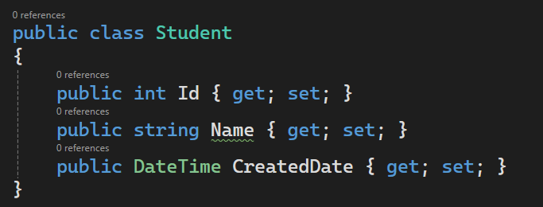
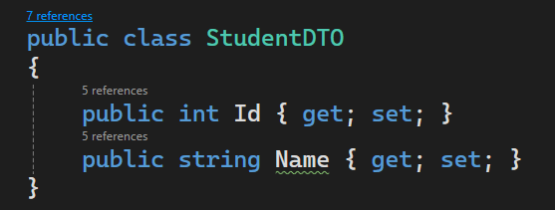
2. Add DTO - StudentDTO

Slide 15
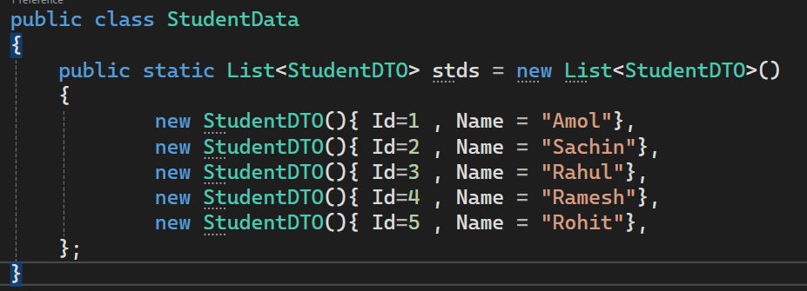
3. Create Student Repo

Slide 16
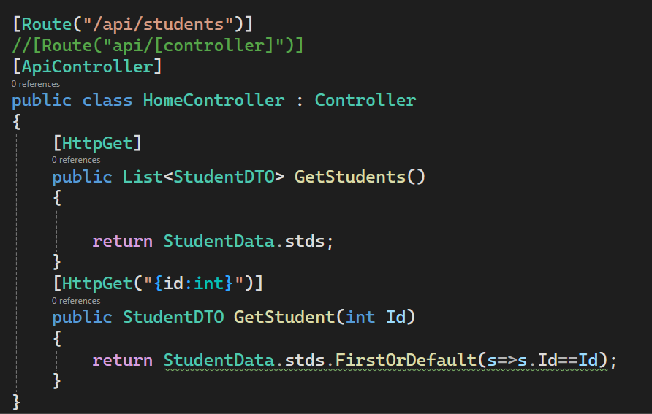
4. Find Student By Id

Slide 17
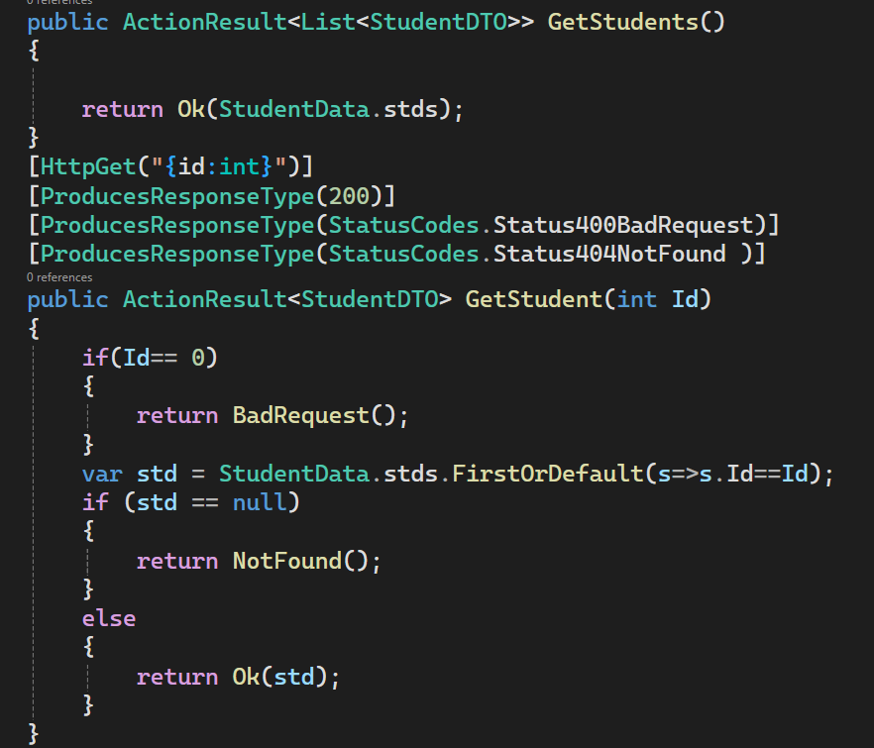
5. Add Response Codes

Slide 18
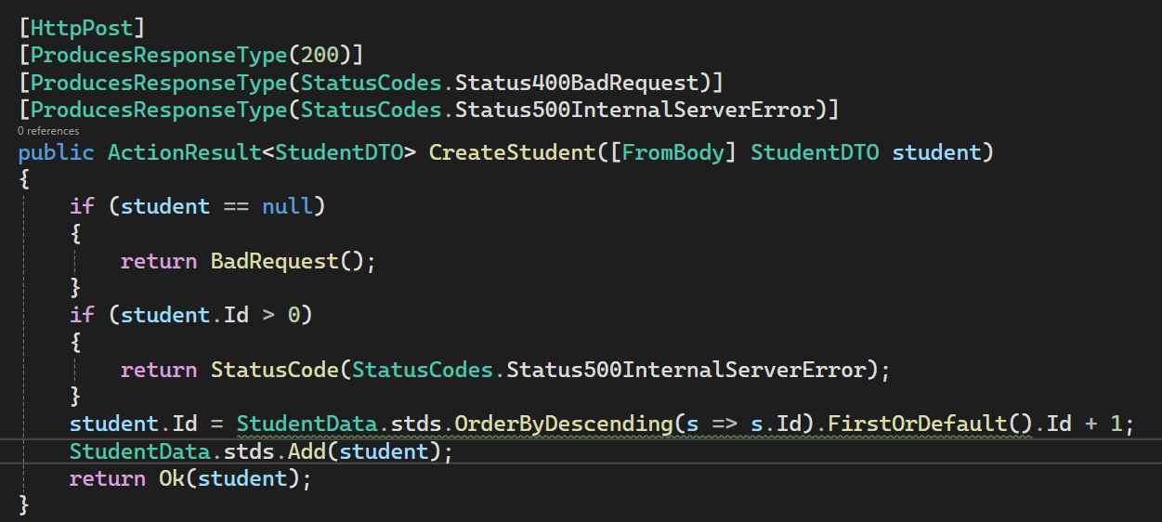
5. Add Post Method

Slide 19
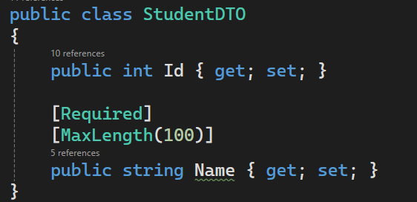
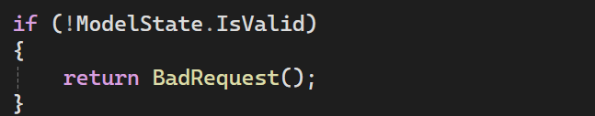
6. Add Model Validation

Slide 20
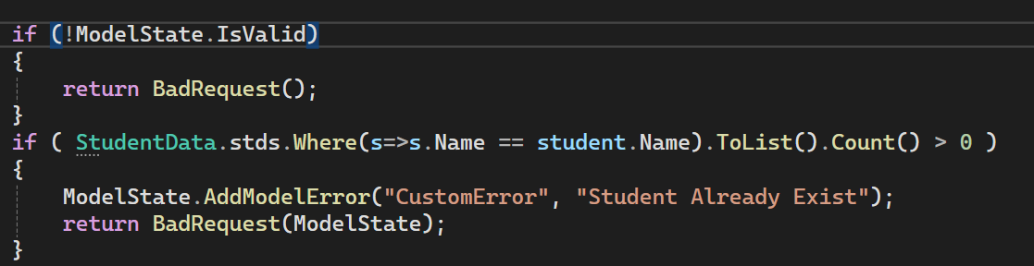
7. Add Custom Validation

Slide 21
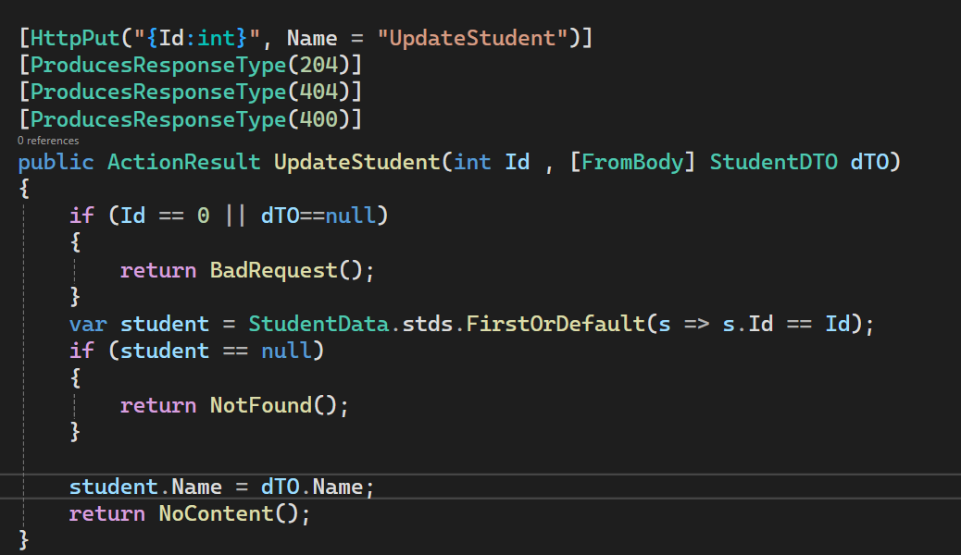
9. Update Operation

Slide 22
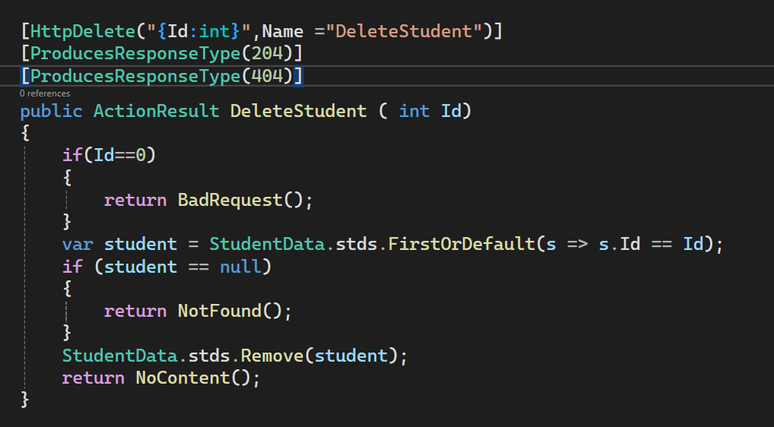
8. Delete Operation

Slide 23
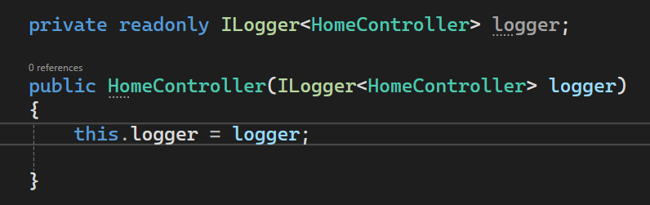
10. Inject Logger

Slide 24
10. Inject Logger

Slide 25
11. Add Nuget Packages

Slide 26
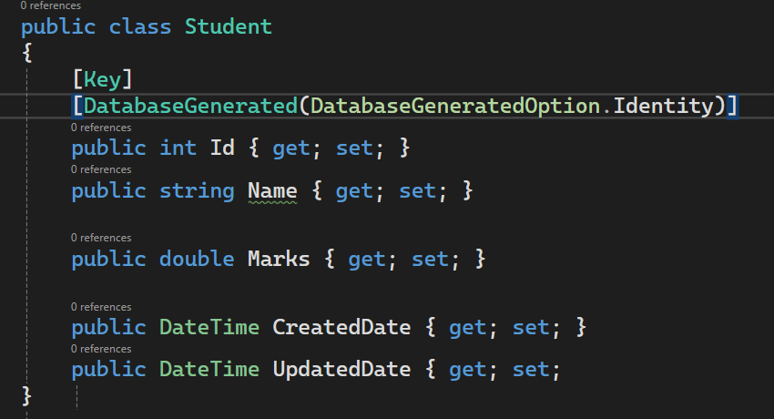
12. Modify Student Class

Slide 27
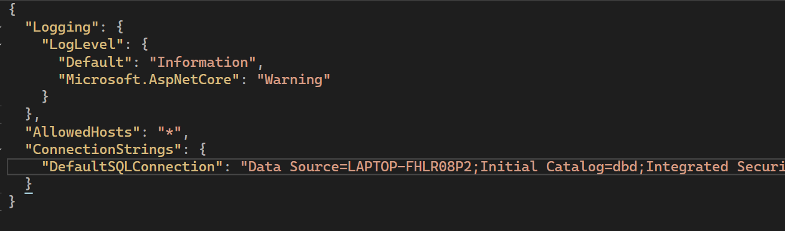
13. Add Connection String in appsettings.json

Slide 28
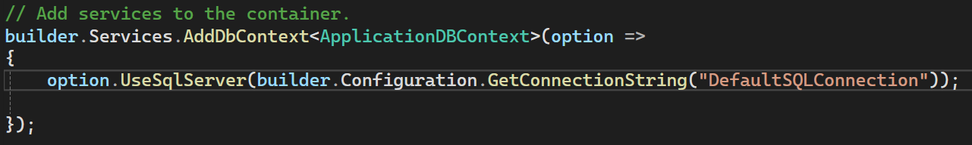
14. Add ConnectionString to Services [ program.cs]

Slide 29
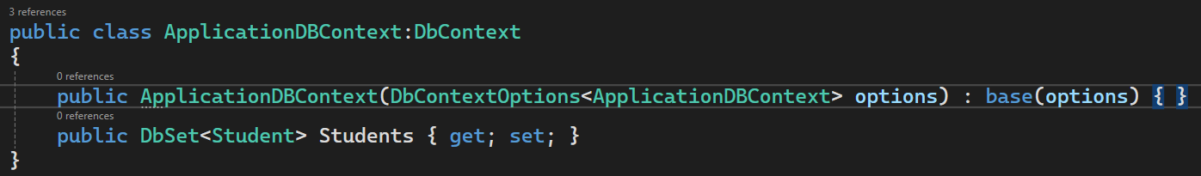
14. Add DBContext class and DBSet

Slide 30
15. Apply Migrations
Add Migration <name>
Update-Database

Slide 31
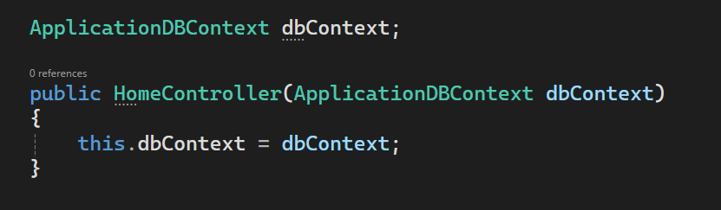
16. Inject DBContext in Controller

Slide 32
17. Make Changes in Controller

